Slide 1


What is Artificial intelligence?
Introduction to Machine learning and deep learning
Abdallah Hesham Mohamed

Slide 2
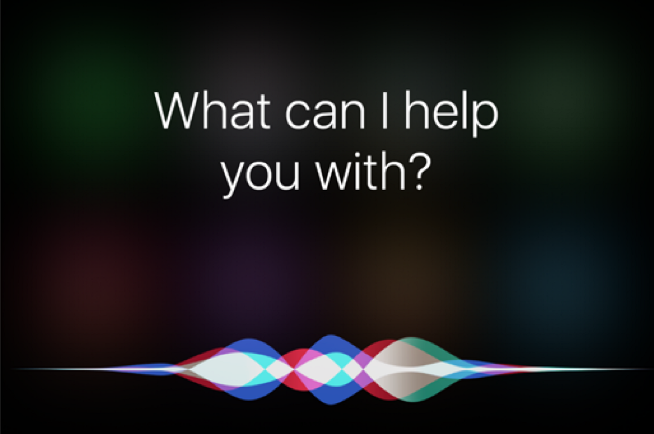
We encounter AI in many aspects of our life
Alexa, Siri and google assistant
Washing machines
YouTube recommendations
Dancing robot?

Slide 3
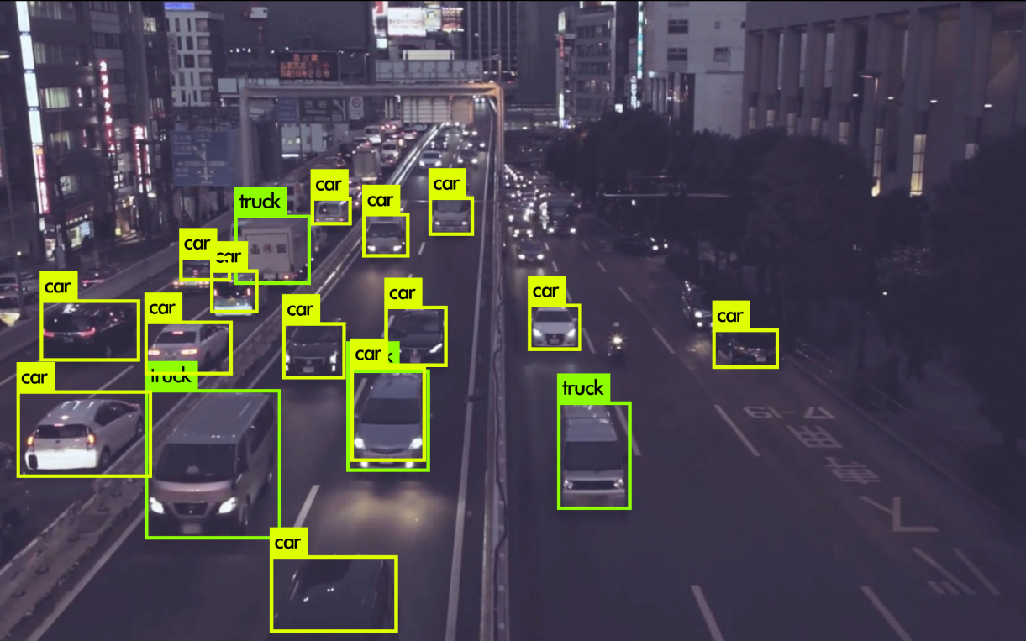

More AI
Source
Cortana’s smart response

Slide 4
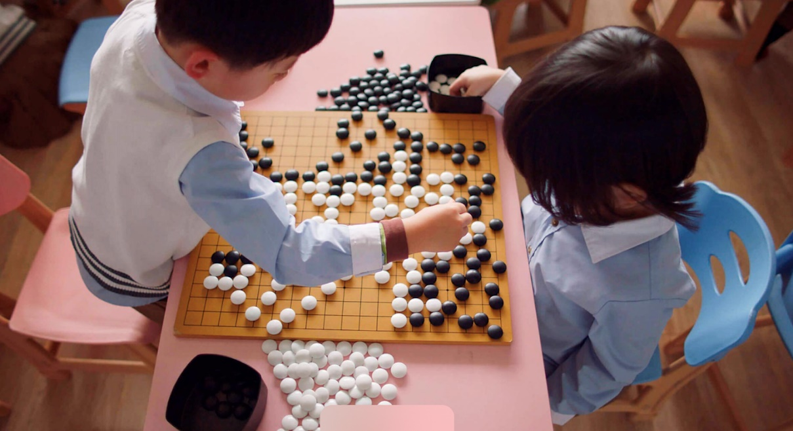
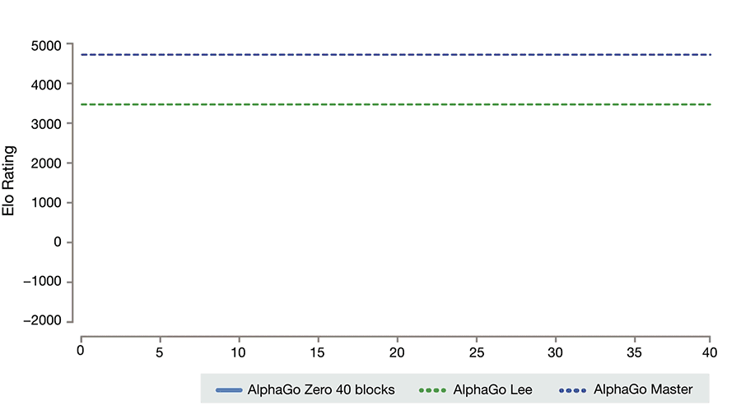
Beating humans?
Source: Deepmind.com

Slide 5

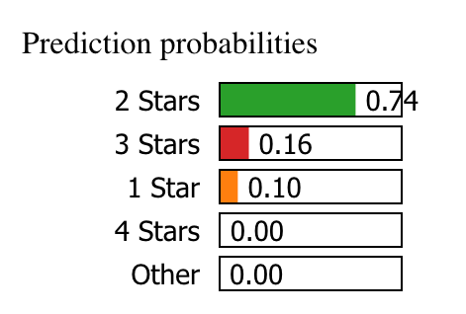
Even More AI
Source
Source

Slide 6
So, can we define AI?
“Artificial Intelligence (AI) is the part of computer science concerned with designing intelligent computer systems, that is, systems that exhibit characteristics we associate with intelligence in human behavior – understanding language, learning, reasoning, solving problems, and so on.” - (Barr & Feigenbaum, 1981)

Slide 7
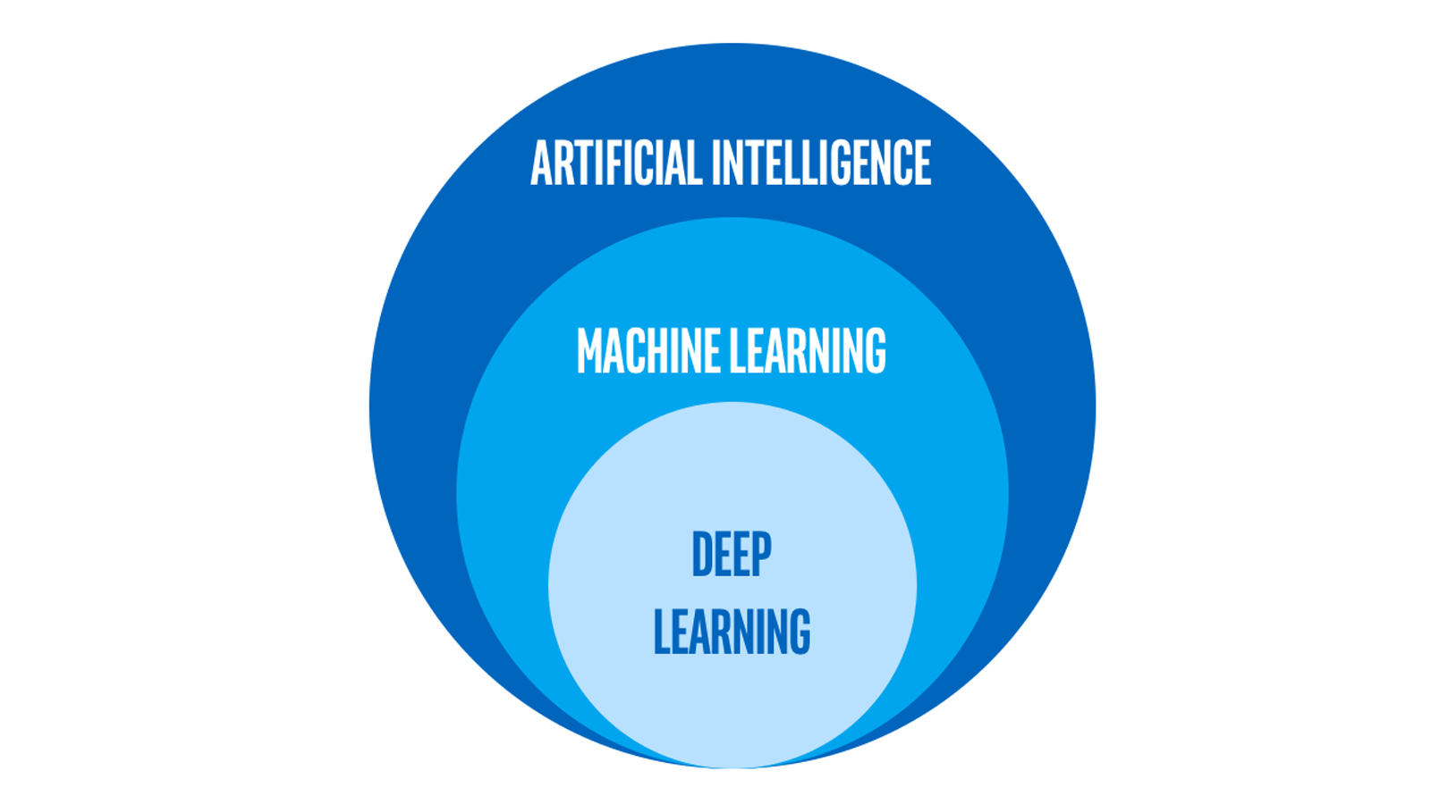
Machine Learning, Deep learning and AI
Intel.com
“Just as electricity transformed almost everything 100 years ago, today I actually have a hard time thinking of an industry that I don’t think AI (Artificial Intelligence) will transform in the next several years.” ~Andrew Ng

Slide 8
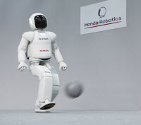
In how many ways can we learn soccer?
Supervised Learning
Unsupervised Learning
Reinforcement Learning
https://asimo.honda.com/gallery.aspx

Slide 9
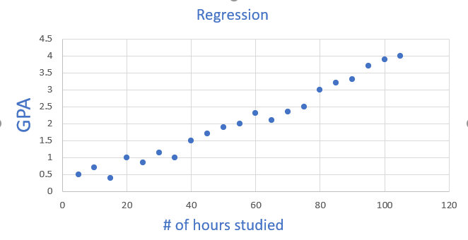
So, can machines actually learn?
Well, AI made that possible!
Y= AX + B
Y= 0.85X + 0.65

Slide 10
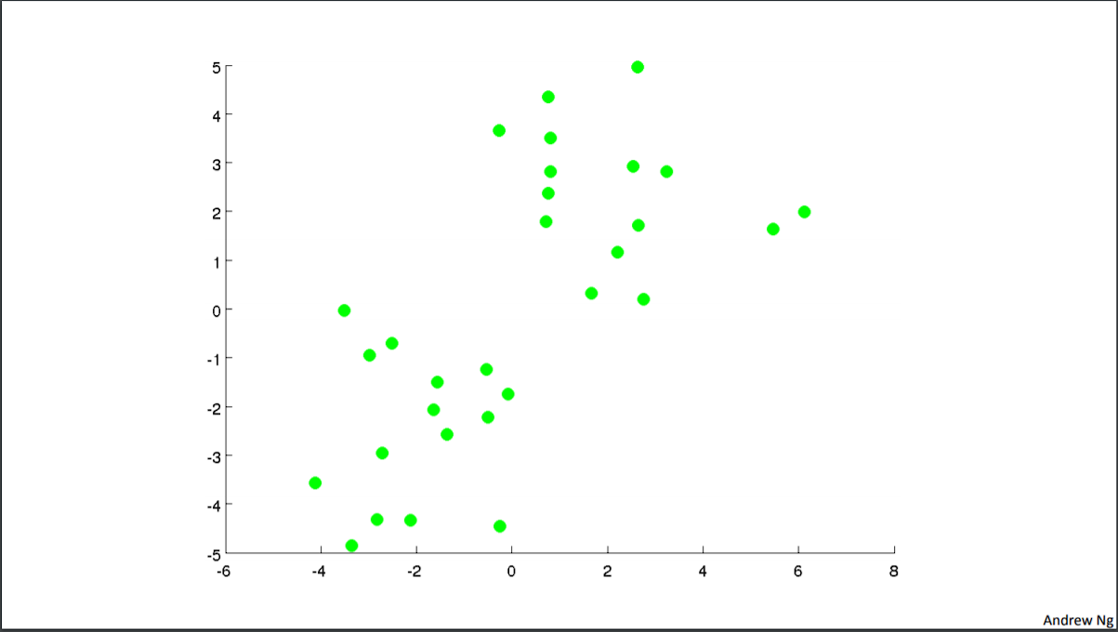
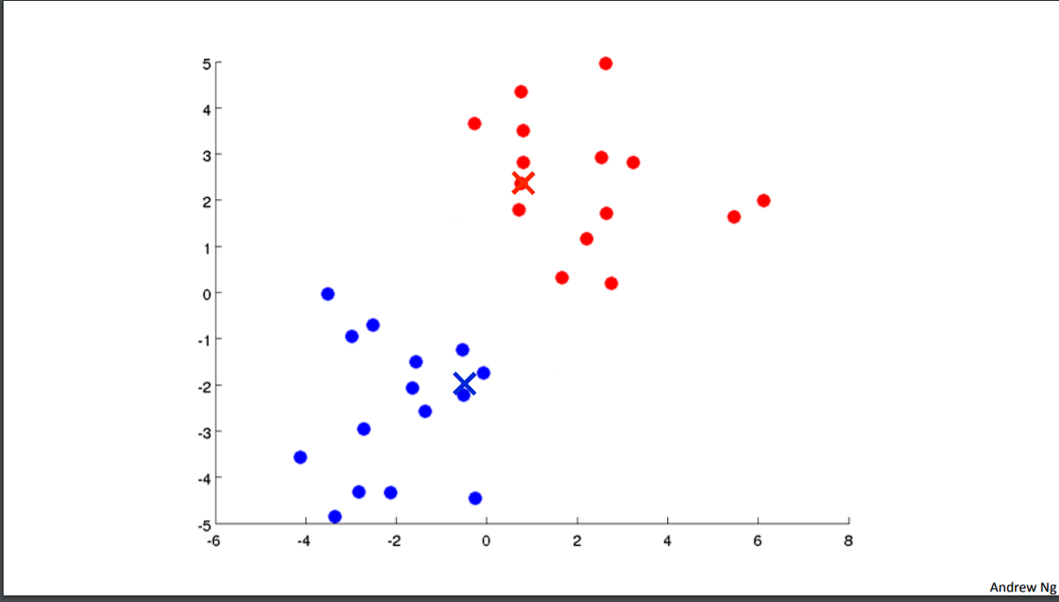
Unsupervised Learning Example (K-Means)
Source: Andrew ng Lectures

Slide 11
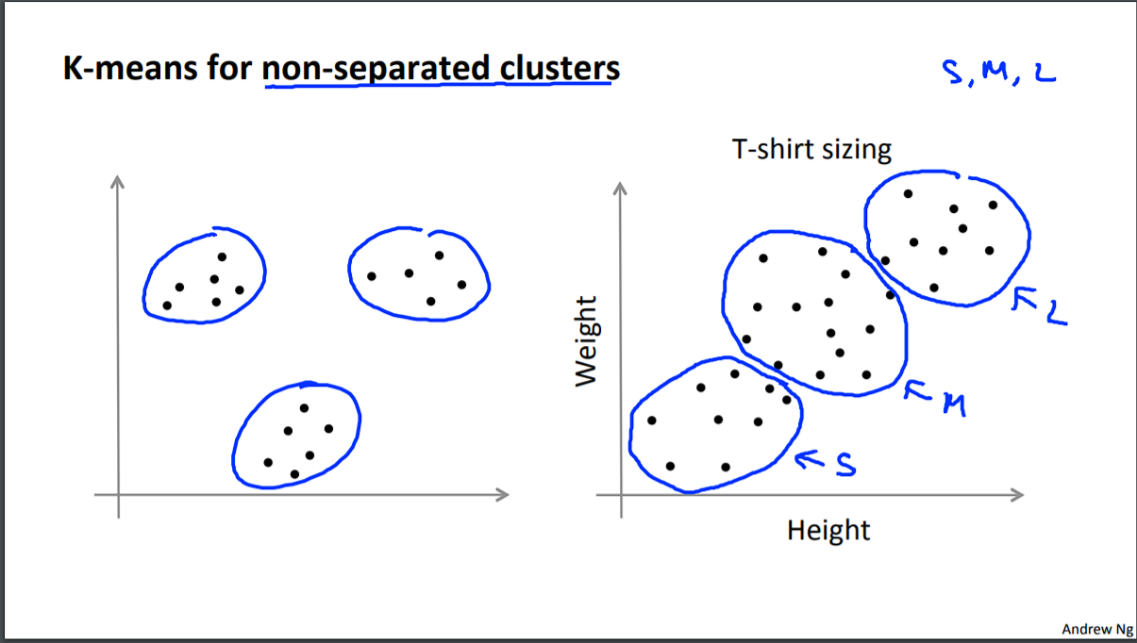
K means Clustering Application
Source: Andrew ng Lectures

Slide 12
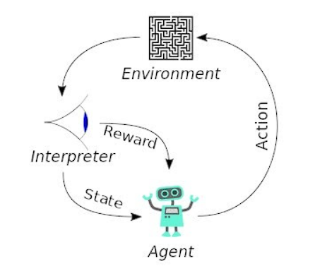
Reinforcement Learning
Check this link
DeepRacer
Source: https://upload.wikimedia.org/wikipedia/commons/1/1b/Reinforcement_learning_diagram.svg

Slide 13
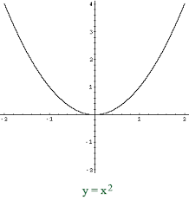
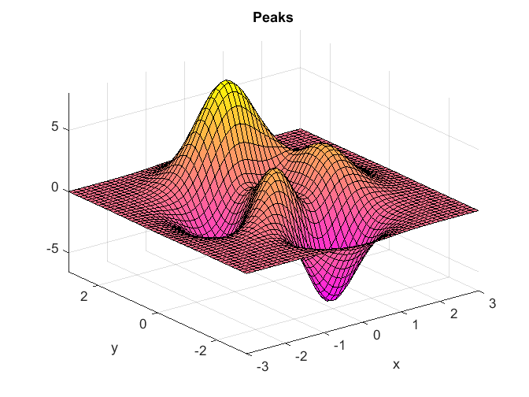


Cost function $J$ and gradient descent
$W_{0}$:=$W_{0}−α ∗\frac{∂J}{∂W_{0}}$

Slide 14
Let’s Implement Linear Regression!
- We Will use Sklearn, Pandas, Numpy and Jupyter notebook
Meet Kaggle

Slide 15
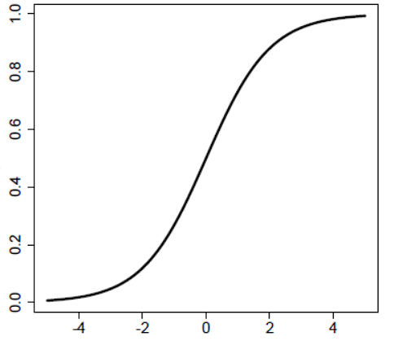


Logistic regression
What if we apply a certain function, called activation function to the output of the linear regression ?
We will assume the linear regression output is called z
Z = $w_{0}+w_{1}∗x_{1}+w_{2}∗x_{2}$
Sigmoid function
$$g\left(z\right)= \frac{1}{1+e^{−(w_{0}+w_{1}∗x_{1}+w_{2}∗x_{2}+…)}}$$
g(Z)
Z

Slide 16
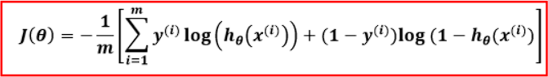
Logistic Regression
Because we applied the sigmoid function, the output will always be between 0 and 1
We use a loss function called binary cross entropy loss for this type of problems

Slide 17
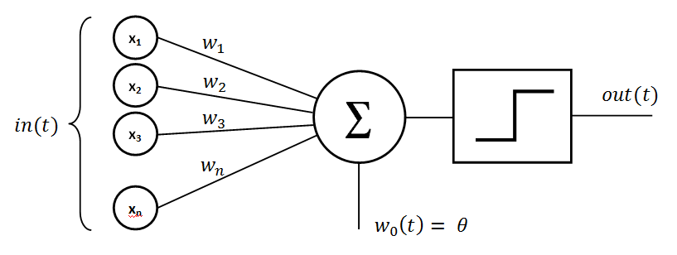
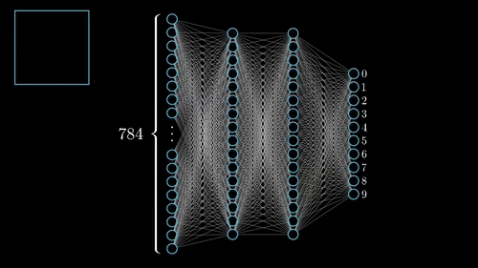
How a neural network looks like ?
By Mayranna - Own work, CC BY-SA 3.0, https://commons.wikimedia.org/w/index.php?curid=30128320
By 3Blue1Brown https://www.3blue1brown.com/

Slide 18


Neural Networks vs…..Actual neurons
From Wikipedia.com
https://www.qwaym.com/our-minds-are-perfectly-intertwined-science-agrees/connected-minds/

Slide 19
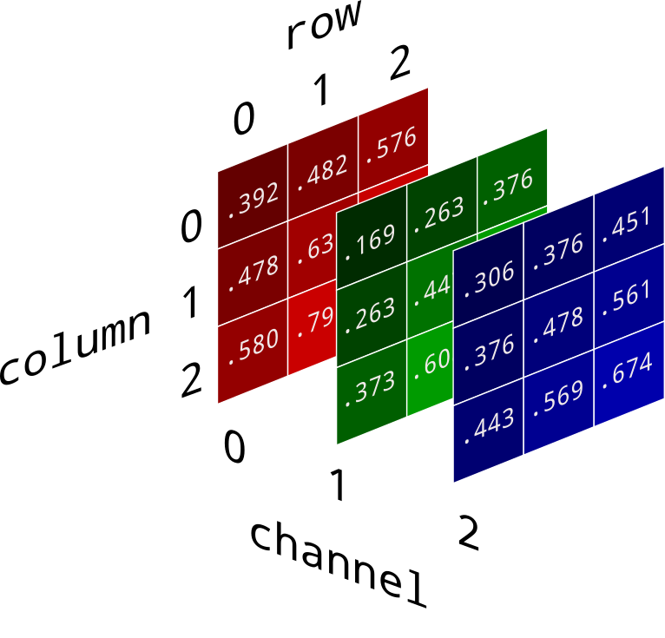

3*3= 9
28*28=784

Slide 20
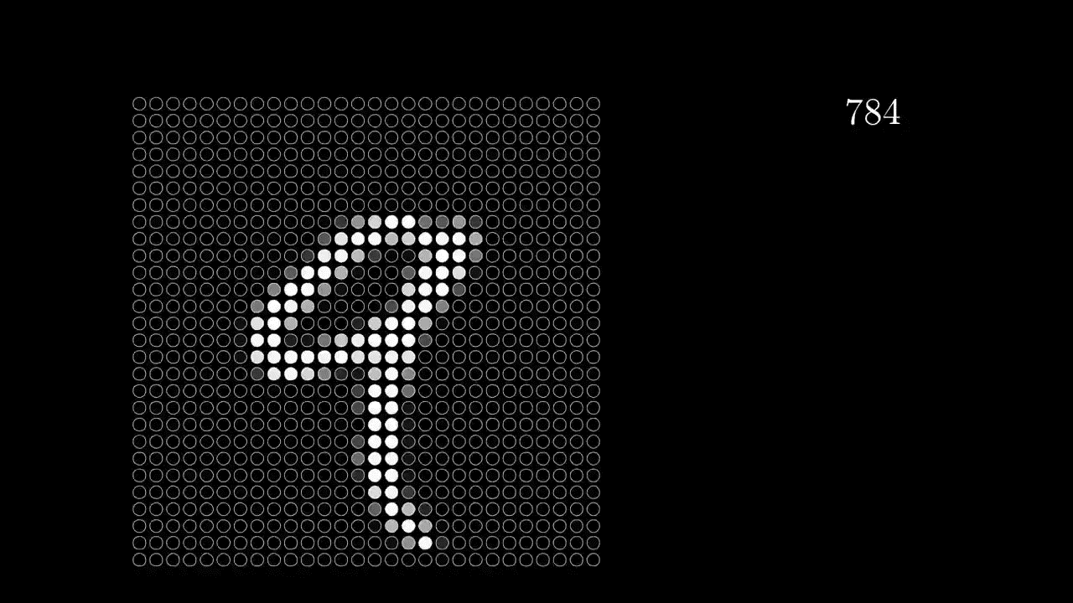
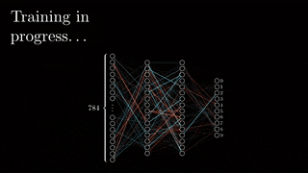
How images are fed into the neural network
By 3Blue1Brown https://www.3blue1brown.com/

Slide 21
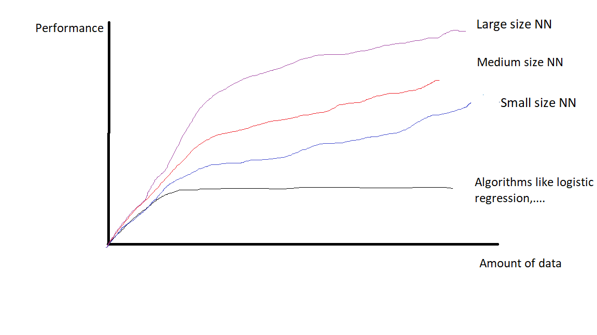
Why deep learning got very famous lately?

Slide 22
Thank you
Abdallah Hesham Mohamed abdallah.hesham@ieee.org

